Slide 1
National Board Certification Cohort
Differentiation

Slide 2
Questions
Have you registered for NBC yet?
https://nbcmsprod.perfrms.com/
Questions that have come
up since JumpStart?

Slide 3
Peer Feedback
Productive feedback has an effect size of .65 (anything above .40 is considered remarkable), this means that students who receive or participate in productive feedback gain an average of 3.5-4 additional months of growth each year (Hattie, 2013).
Notes:
Remind candidates that they may not feel productive, and they may feel like they don’t know what they are talking about, but they do, and a lot of the growth has to do with the processing they can do together.

Slide 4
Productive Feedback
Clarifies and shares learning intentions and criteria for success.
Engineers effective classroom discussions, questions, and learning tasks.
Provides feedback that moves learners forward.
Activates students as the owners of their own learning.
Activates students as instructional resources for one another.
(Wiliam, 2005)
Notes:
Remind them that these attributes of productive feedback are being used today for them to offer peer feedback, but they are the same attributes that they should be considering when providing feedback for students in their classes.

Slide 5
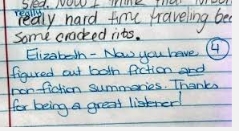
Key Elements of Feedback for NBC
Feedback should be thoughtful and reflective, not
“Good Job” and not just stickers!
Evidence of WHY you provided the feedback and
HOW it impacted student learning should be
clearly articulated in your writing.
Write feedback so you can provide copies
in your component to submit.

Slide 6
Peer Feedback and CSP Feedback
Notes:
Let them know that this is the kind of feedback we offer candidates, so they shouldn’t be freaked out when they send us their writing.

Slide 7
Important Notes
Embedding your questions….
Answering your questions…
We encourage you to request feedback from different CSPs (we all bring unique qualities and knowledge to the process)
Notes:
If they don’t embed their questions we will just send their work back. E-mail questions, please never feel like the question isn’t worthy or you are bothering us. We want to be your support system, so just ask!

Slide 8
Feedback from peers
Make revisions
Feedback from CSP
Make revisions
Move to next component
Notes:
Explain that this is the feedback process for us. They must receive feedback from peers (other candidates, others NBCTS, and then other colleagues), then they make those revisions. Then send it to us for feedback. We should be getting raw unedited work., then you get feedback from us (note the double arrow in this area), we suggest that you get feedback from a different CSP after you make revisions before moving to a new component

Slide 9
Feedback Norms
Please allow 10 days for CSP feedback
Only send your writing to ONE PERSON AT A TIME
Embed the questions or we will send it back
We have 25 different certificates, all questions are different
We strongly encourage you to have outside readers
DO NOT PAY ANYONE
If you receive contradictory feedback, ask us!! This is a new process so anyone you ask will not have attained Boards in the same way

Slide 10
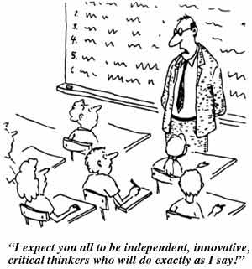
Suggestions For Planning

Slide 11
How can we differentiate?
Teachers can differentiate in four key areas:
Content
Offering students choice within the content you are already teaching is a great way to differentiate content that meets both your needs and the students interests
Process
We don’t all learn the same way, make sure that you plan with different learners in mind and you units have a balanced inclusion of different processing opportunities
Product
Differentiating students product is a fun and easy way to offer them choice and tend to their learning styles too
Environment
We often see differentiation of environment more in ES classrooms, stations and even small changes in the classroom environment changes a mood, tone, and expectations for all students

Slide 12
Teachers Differentiate
Content
Process
Product
Environment/Affect
By Students
Readiness
Interest
Profile
Notes:
Teacher is responsible for attending to how their content is structured for meaning and authenticity, who their students are, and connecting the content with the learners in a student centered environment.
Teacher plans the top in response to the where the student’s differences

Slide 13
Summary
Content
Process
Product
Environment
What we teach and how it’s presented
Formative sense making activities & assessment
Summative assessments/ Transfer Goals
How it feels in the classroom
Learning Profile
Readiness
Interest
Preparing for different student ability levels
Allowing students to make good choices
Utilizing student preferences, culture and thinking styles

Slide 14
Differentiation is NOT a different lesson for each student!!
Differentiation is teachers planning to promote equity through multiple access points into the curriculum

Slide 15
Please use the rest of our time together to give and receive feedback from your peers on your instructional context/student profile and work with one another to plan how you are going to differentiate!
We encourage you to have candidates from outside of your certificate area read your work

Slide 16
Homework for October 15th
Rough draft of Component 2 written commentary
All sections, with artifacts that you will be using.
Notes:
Encourage candidates to collect all their evidence before break, so they have time over break to write the commentary

