Slide 1

Component One
April 29, 2017

Slide 2
What is Component 1?
A test that assesses fundamental content and pedagogical knowledge
Covers the entire developmental age and content for a given certificate
Notes:
Time: 2:00
Materials: none
Notes: Mention that Component 1 assesses both content and pedagogy; for teachers of younger students the emphasis is more on pedagogy, while for teachers of older students the emphasis is more on content. Explain that candidates are responsible for the entire range of the certificate, regardless of their specific teaching assignment.

Slide 3
What is Component 1?
Two Parts:
  45 Selected Response Items (SRIs)
    Stand-alone items
    Includes a short passage with related questions
  Three Constructed Response Exercises (CREs)
    Consists of one or more prompts/questions
    Scenarios
Notes:
Time: 2:00
Materials: none
Notes: This is simply an explanation of the two parts of the assessment.

Slide 4
Component One in Context
CRE 1= 6.67%
SRI = 20% of total score
C 3
30% of total Score
C 4
15% of total Score
C 2
15% of total score
CRE 2= 6.67%
CRE 3= 6.67%
SRI= 20%; CREs = 20-%
40% of Total Score
C2, C3, C4 Composite Score
60% of Total Score
Notes:
Time: 4:00
Materials: none
Notes:
There are three score requirements in order to achieve National Board Certification. They are
-- Assessment center section average score of at least 1.75 – The unweighted average score of
the three constructed response items raw rubric scores and the selected response item section
converted score must be at or above 1.75.
-- Portfolio section average score of at least 1.75 – The unweighted average score of the
three portfolio component raw rubric scores must be at or above 1.75.
-- Total weighted scaled score at or above the cut score - To be determined in 2017 after
standard setting.
We have kept CRE rather than SRI. Both are used on NB documents, but CRE is used much more frequently.
Candidates may be a bit overwhelmed at this point, so help candidates understand that this process is about growing and learning. If they don’t know everything, it’s okay.
Return to depth of knowledge – now how do you feel about having to write about this.

Slide 5

Analyzing the Sample Questions
Find your 5 sample SRI questions.
Take the sample test individually (5 minutes of silent work)
http://www.cliparthut.com/clip-arts/101/number-five-clip-art-101901.png
Notes:
Time: 6:00 (1:00 to find materials, 5:00 to answer the 5 questions)
Materials: Component 1 materials, something to write on.
Notes: Some candidates may have already discovered and answered these questions; if so, they can just sit this one out.

Slide 6
The Importance of Studying!
0 Hours of Studying = All Answers Look Correct
5 Hours of Studying = 3 Answers Look Correct
10 Hours of Studying = 2 Answers Look Correct
15 Hours of Studying = 1 Answer Looks Correct
Notes:
Time: 1 minute
Material: None
Notes: There is nothing scientific about this data; it’s presented merely as a way to crystalize the idea that multiple-choice questions become easier and easier the more you study for them. Candidates need to understand that this is a hard test, it’s an important test, but it’s a test they can study for.

Slide 7
Practice a Constructed Response Exercise
You will need:
  Your Sample CREs (found in the Component 1 Sample Items and Scoring Rubrics )
  Scoring Rubrics for each (directly following each exercise)
Remember, the range of the exercises is matched to the certificate, NOT your job.
Notes:
Time: 25:00
Materials: The set of CREs found in the Component 1 directions, along with the Scoring Rubrics for each Exercise that follow each of the three sample exercises.
Notes: We have kept CRE rather than CRI. Both are used on NB documents, but CRE is used much more frequently.
Give candidates 20-25 minutes to compose a response to one of their Constructed Response Exercises. They may want to chose the same exercise as everyone in their like-cert group. Then, have candidates file this response away for now. We will revisit and reflect on it later.

Slide 8
Steps to “tackling” your goals
Brainstorm
What strategies can you use to teach yourself this content?
Determine or review your own learning styles
Identify your strengths and weaknesses
Determine resources you can use
Notes:
Time: 12:00
Materials: none
Notes: This is a chance for candidates to discuss with a partner how they learn. They idea is to articulate how they function as a learner.

Slide 9
Steps to Mastery
Target Your Weakest Areas and Skill Sets
Train Yourself in Those Areas
Test Yourself by Practicing Your Skills in the Classroom
Transfer What You Have Learned As You Grow and Progress Through the Other Components
Trust Yourself and Take What You Know to the Testing Center
Notes:
Time: 2 minutes
Materials: none
Notes: this is simply a list of ideas successful candidates use to prepare for Component 1. Feel free to add other ideas during the discussion.
Determine or review your own learning styles
Identify your strengths and weaknesses
Determine resources you can use
(look at slide with resources later in the presentation)

Slide 10
Selected Response Items
  Examine the Standards Content Measured by Selected Response Items for your content area
Notice that it contains bold headings and bulleted content topics for each heading.
It also lists the standards addressed.
The % listed is a tool to let you know how many questions from each content heading to expect.
NOTE: There is overlap in content between the SRIs and CREs.
Notes:
Time: 3:00
Materials: NB-provided table included with Component 1
Notes: Orient candidates to the information provided in this table. There’s an example on the next slide.

Slide 11
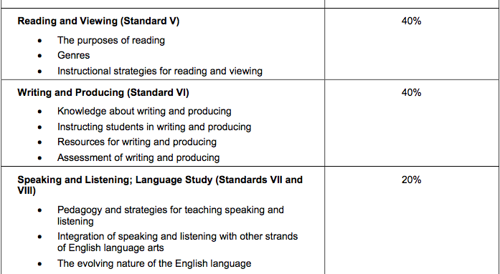
An EA/ELA Sample
Standards Measured
Approximate Percent
Notes:
Time: 2:00
Materials: Each candidates should be looking at their certificate table.
Notes: Candidates need to understand that they’ll need to extend their study beyond their NB standards, although that’s the best place to start. For example, once they know that “genres” will be covered by this assessment, they’ll need to access resources that provide in-depth information about genres. Their NB standards do not do this.

Slide 12
Important Vocabulary:
The stimulus is the information with which you are provided.
  Scenario
  Situation
  Set of Data
The prompts are the questions you must answer in response to the stimuli.
  Identify
  Describe
  Analyze
Notes:
Time: 2:00
Materials: none
Notes: This is an important vocabulary distinction. We use the word “prompt” instead of “question” simply because the prompts are usually not stated in the form of questions.

Slide 13
The Bottom Line
At the end of the day, you are responsible …
  For figuring out what you need to know
  For gathering the appropriate materials
    and…
  For studying them!
But the good news is…
  You have an Accomplished Teacher as your tutor! (you)
Notes:
Time: 1:00
Materials: none
Notes: We want candidates to assume responsibility for their own preparation, and to feel confident in their ability to do so.

Slide 14
Assessment Schedule
SRI | 45 questions, 60 minutes total* *75 minutes for: AYA and EA ELA AYA and EA Math AYA Physics AYA Chemistry
Break | 10 Minutes (exactly)
CRI | 3 questions, 30 minutes each, 90 minutes total
Notes:
Time: 1:00
Materials: none
Notes: this is a simple explanation of their test day.

Slide 15
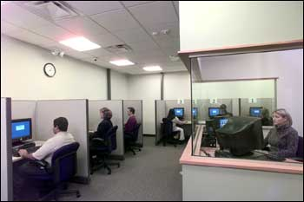
What you can bring in:
“Minor Comfort Aids” including:
Tissue
Unwrapped Cough drops
Pillow
Insulin
White board (provided)
Notes:
Time: 1:00
Materials: none
Notes: Add other information from your own experience.

Slide 16
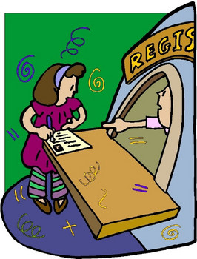
When and How to Register
After your fee is paid in full and you receive your “Authorization to Test” email
Contact the Pearson VUE test Center:
  PearsonVUE.com/NBPTS
  1-888-288-3028
    7AM-7PM CT M-F
Remember, you are responsible for scheduling within the testing window
Refer to the 2016 Component 1: Content Knowledge Assessment Center Policy and Guidelines for complete information and directions
Notes:
Time: 2:00
Materials: none
Notes: see slide

Slide 17
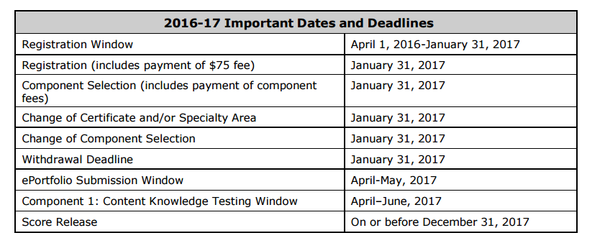
When to Take It
For the 2016-2017 Candidate Cycle:
Testing Window is April-June of 2017
Consider in Relation to Component 2-4 Deadlines
Notes:
Time: 1:00
Materials: none
Notes: this information is not yet on the NB website

Slide 18
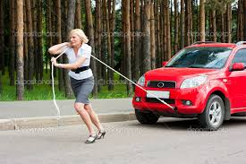
One Week Before Assessment
Pre-visit, if possible
Make sure you call the AC to confirm your appointment
Plan for child-care, etc.
Check your car
Stay healthy!
Notes:
Time: 1:00
Materials: none
Notes: see slide; add personal information if possible

Slide 19

Test Day
Be rested and well-fed
Arrive at least 30 minutes before your scheduled appointment
Bring:
  Your Authorization to Test or Admission Ticket
  Photo ID bearing your signature
http://www.cliparthut.com/clip-arts/621/drivers-license-621806.jpg
Notes:
Time: 1:00
Materials: none
Notes: Remind them to consult the website and their Component 1 instructions for current information.

Slide 20

Ethical Issues
Don't ask about the specific content of the assessment questions.
Don't tell anyone about the specific content of the questions.
And besides, the specific content of the questions will be different.
Notes:
Time: 1:00
Materials: none
Notes: Be sure to address the seriousness of sharing questions – can lose opportunity to pursue NB

Slide 21

Not all Assessment Center experiences are created equal!
Certificates including a specialty at the Assessment Center:
    EMC/English as a New Language
    EAYA/English as a New Language
    ECYA/Exceptional Needs Specialist
    AYA/Science
EA and AYA/Math are provided a response book
Check your specific certificate requirements for complete information
Notes:
Time: 1:00
Materials: none
Notes: Still TBD; music presentation and World Language is still being worked on; paper and pencil?; encourage candidates to find out about their own cert

Slide 22
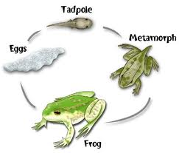
Things Change!
Please visit the National Board website to make sure you have the current information on your specific Component One Items.
Notes:
Time: 1:00
Materials: none
Notes: This is basically a disclaimer; we don’t want to be responsible for changes made by the NB. Candidates are ultimately responsible for knowing the current information posted on the NB website.

